Slide 1
SQL
Data engineering with SQL

Slide 2

About Me
Education
Master degree – FINKI –
Faculty of computer science and Engineering - Skopje (2008-2012)
Bachelor’s degree – FEIT –
Faculty of Electrical engineering and Information technologies – Skopje (2003-2008)
Working Experience
Seavus Group ( 2013 – Ongoing)
Komercijalna Banka (2008-2013)
Ultra doo (2007-2008)
Current job position
Data architect and Technical lead at Seavus
Contact mail:
blagojk@gmail.com
LinkedIn profile:
https://www.linkedin.com/in/blagojkostovski/

Slide 3
Course organization
Monday, Wednesday, Friday – regular sessions(18:00-2 0:00)
Topic explained in theory and with examples
Hands – on – task that needs to be implemented
Workshop sessions – larger exercises related to learned material
Weekly challenges (Friday – expected by Monday) – you get points for that
Try at home exercises – you don’t get points for that
Saturday – 5 on 1 Q\A sessions
Group 1 – 9:00 – 10:00
Group 2 – 10:00 – 11:00
Short brakes
1 break of 10 min, around 19:00
Sharing your screens to explain the solution or detect the problem
Provide all code that was generated during the session

Slide 4
Groups for Q\A 5-1 sessions
Group 1 (09:00-10:00)
Jakub
Ozren
Darya
Bojan
Valentin
Group 2(10:00-11:00)
Rest of the group

Slide 5
Open topics for Q\A
Possibility to speed-up the recording? Blagoj to check
[First Name] as column name – test it (Bojan)

Slide 6
Challenge 1
Constraints
Add default constraint with value = 930 on PurposeCode column in AccountDetails table
Add Unique constraint on Name column in Location table
Add Check constraint on Account table to prevent inserting negative values in AllowedOverdraft column
To be submitted by: 09.04.2021

Slide 7
Challenge 2
List all Employee first names that doesn’t exist as Customer first names
List all Customer first names that doesn’t exist as Employee first names
List First names that are present as Customer first name and Employee First name
To be submitted by: 17.04.2021

Slide 8
Challenge 3
Using Subqueries prepare list of ATM locations (Location Name) where you will list all ATM ‘s where there was at least 1 outflow transaction greater than 150 EUR in month 03.2019
To be submitted by: 23.04.2021

Slide 9
Challenge 4 - Friday
Prepare query with 2 most often used locations for transactions for the male customers and for the female customers.
This are the columns expected on output (note: data shown here is just an example and it is not showing the final expected result)
To be submitted by: 28.04.2021
Gender | Location | Total transactions in this year
Male | ATM Vienna 1 | 100
Male | Salzburg branch office | 95
Female | Daily clearing | 55
Female | Graz branch office | 45

Slide 10
Challenge 5 - Functions (ready by 01.05.2021)
Create scalar function that for input parameter @NationalIDNumber will return the SUM of current balance on all EUR accounts he has.
Create table valued function that for input parameter @NationalIDNumber will return resultset with CurrencyName and current balance
CurrencyName | CurrentBalance
EUR | 10.000
USD | 500

Slide 11
Challenge 6
Prepare new procedure that will read from the log table (related to Hands on day 2 – for procedures – slide 195)
Procedure name: WhoViewedTheReport
Procedure should show the Employee full name, Customer Full name and the datetime when the Employee opened the report
Procedure should have following input parameters:
FromDate dateime
ToDate datetime
Based on the input parameters, procedure should return only the logs from generated reports that occurred within the specific date interval on input
To be submitted by: 01.05.2021

Slide 12
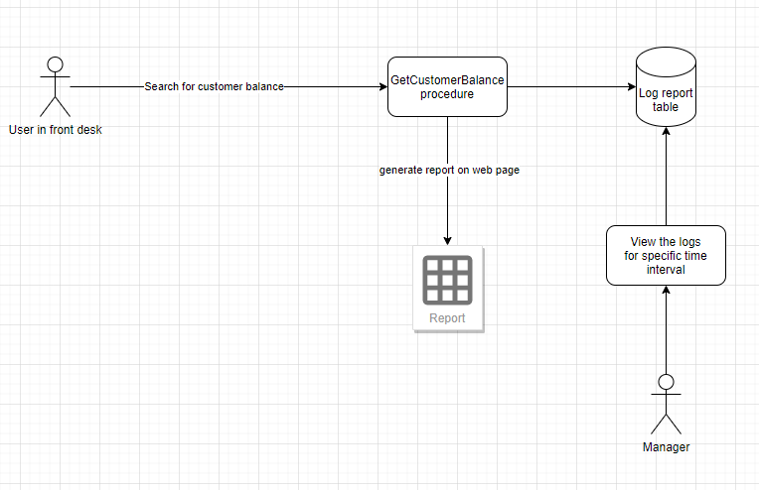
Challenge 6 – visual representation

Slide 13
Deadline for all challenges
09.05.2021 – 23:59

Slide 14
1. Working environment setup

Slide 15
DBMS and Databases
Database 1
Database management system
User
Database 2
App
Service
Database N

Slide 16
DBMS and Databases
Windows
Linux
Docker container
Management studio
Azure data studio
Database 1
Database management system
User
Database 2
App
Service
Database N
Notes:
Why run on Docker container:
Speed and consistency

Slide 17
Working environment – preferable choice
SQL Server service
Docker container installation
SQL Server on Docker configuration
Tool to access the database engine
Azure data studio

Slide 18
Working environment – second option
SQL Server service
Windows installation for SQL Server (installation manual will be provided)
Tool to access the database engine
Azure data studio

Slide 19
2. Docker container installation

Slide 20
Docker container installation – system requirements
Following page contains hardware requirements for Docker installation: https://docs.docker.com/docker-for-windows/install/
Key points are:
Windows 10 64-bit: Pro, Enterprise, or Education (Build 16299 or later).
Windows 10 Home (Build 19018 or later)
Hyper-V and Containers Windows features must be enabled.
The following hardware prerequisites are required to successfully run Client Hyper-V on Windows 10:
64 bit processor with Second Level Address Translation (SLAT)
4GB system RAM
BIOS-level hardware virtualization support must be enabled in the BIOS settings. For more information, see Virtualization.
Notes:
https://searchsqlserver.techtarget.com/definition/database-management-system

Slide 21
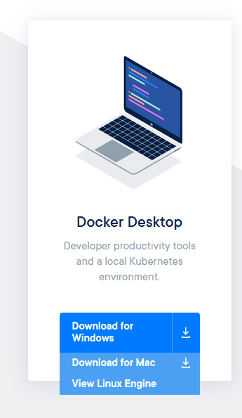
Docker container installation
Download Docker for your OS:
https://www.docker.com/get-started
Notes:
https://searchsqlserver.techtarget.com/definition/database-management-system

Slide 22
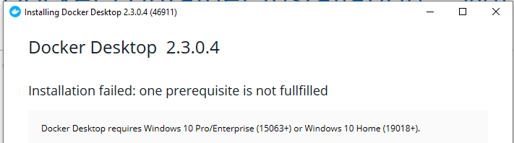
Docker container installation – Windows
Docker container can be installed both on Windows Pro and Home editions. Please check if you have the latest updates from the OS before installing.
If you don’t have the latest OS updates this message will show:
In this case please install latest Windows updates and run the installation again

Slide 23
Docker container installation – MacOS
Download the Mac version of installation file
Supporting video for Docker installation on mac
https://www.youtube.com/watch?v=O4Yro0VN5Ds
(watch between 00:00-01:52)

Slide 24
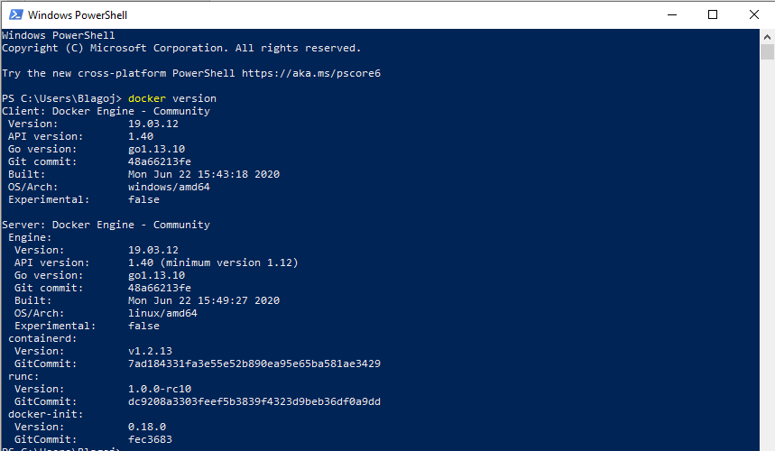
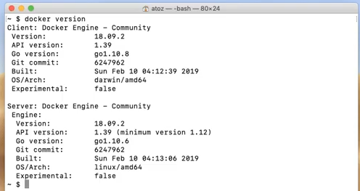
Docker container installation
If everything was installed as expected running the following command will need to retrieve Docker version
docker version
Windows macOS
Notes:
https://searchsqlserver.techtarget.com/definition/database-management-system

Slide 25
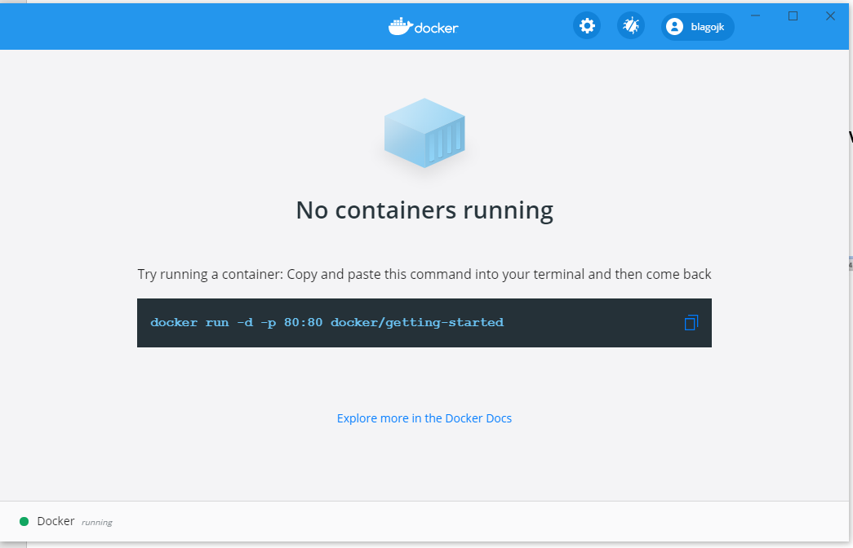
Docker container installation
Additionally, Dashboard user interface with existing containers can be opened from the toolbar for better visibility
Notes:
https://searchsqlserver.techtarget.com/definition/database-management-system

Slide 26
3. SQL Server on Docker configuration

Slide 27
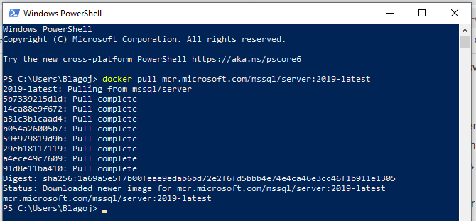
Install SQL Server via docker container on Windows
List of available tags for SQL Server
https://hub.docker.com/_/microsoft-mssql-server?tab=description
Step 1: Execute following command in PowerShell to download the container image:
docker pull mcr.microsoft.com/mssql/server:2019-latest
Notes:
https://searchsqlserver.techtarget.com/definition/database-management-system

Slide 28
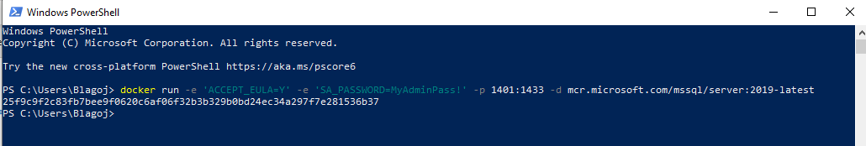
Install SQL Server via docker container on Windows
Step 2: Execute following command in PowerShell to start the SQL Server instance:
docker run -e 'ACCEPT_EULA=Y' -e 'SA_PASSWORD=MyAdminPass!' -p 1401:1433 -d mcr.microsoft.com/mssql/server:2019-latest
Notes:
https://searchsqlserver.techtarget.com/definition/database-management-system

Slide 29
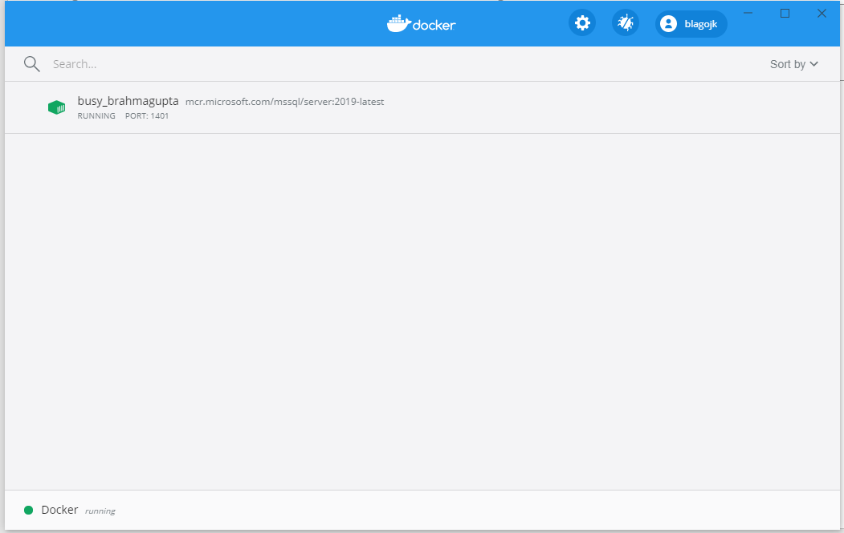
Install SQL Server via docker container on Windows
After installation, the new container should be listed in the docker Dashboard
We will test the connectivity to the server after we install Azure Data studio in the next video

Slide 30
Install SQL Server via docker container on macOS
Same steps as installing on SQL Server on docker container on windows should be performed
Supporting video in case of any issues when installing on macOS:
http://www.notyourdadsit.com/blog/2018/10/5/install-sql-server-2019-via-docker-container-on-mac-os-x
Notes:
https://searchsqlserver.techtarget.com/definition/database-management-system

Slide 31
4. Azure Data Studio

Slide 32
Azure Data Studio - introduction
Windows
Linux
Docker container
Management studio
Azure data studio
Database 1
Database management system
User
Database 2
App
Service
Database N

Slide 33
Azure Data Studio – how to install
Use following page to download the installation file:
https://docs.microsoft.com/en-us/sql/azure-data-studio/download-azure-data-studio?view=sql-server-ver15
Select the appropriate Operating system installer

Slide 34
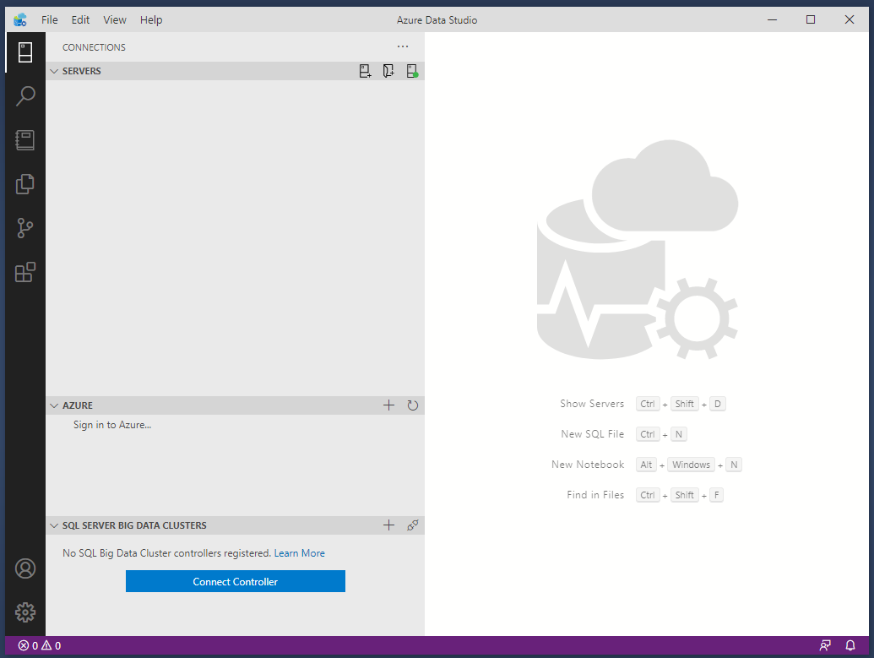
Azure Data Studio – how to install
Notes:
Why run on Docker container:
Speed and consistency

Slide 35
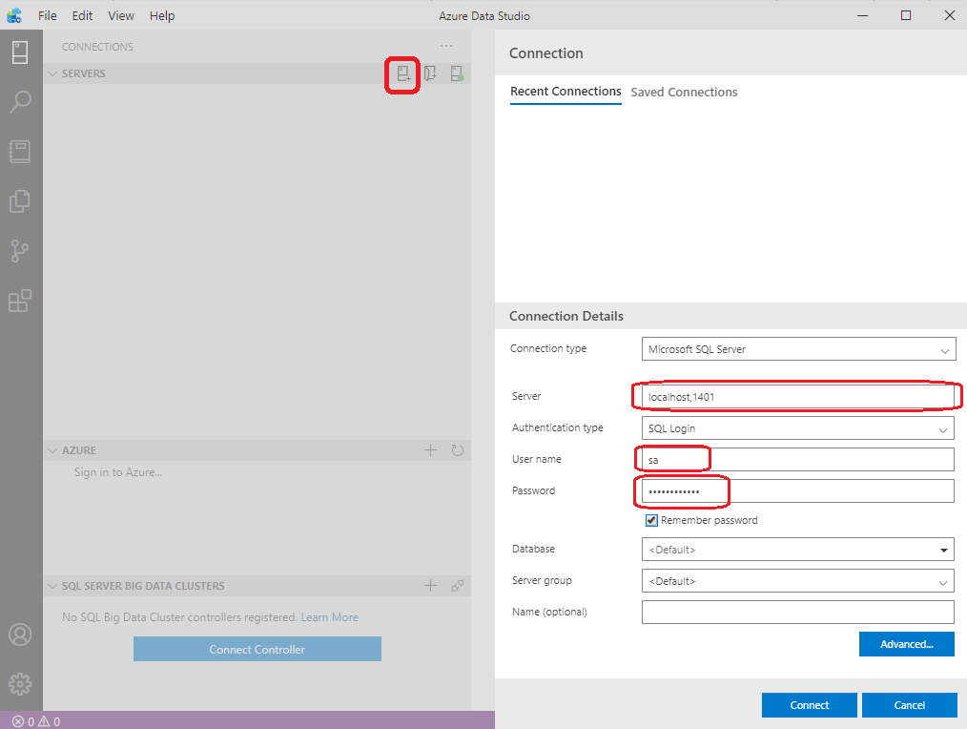
Azure Data Studio – how to connect
docker run -e 'ACCEPT_EULA=Y' -e 'SA_PASSWORD=MyAdminPass!' -p 1401:1433 -d mcr.microsoft.com/mssql/server:2019-latest
Notes:
Why run on Docker container:
Speed and consistency

Slide 36
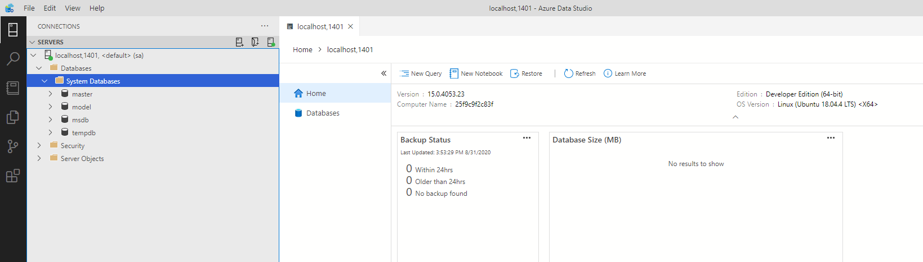
Azure Data Studio – how to connect
Notes:
Why run on Docker container:
Speed and consistency

Slide 37
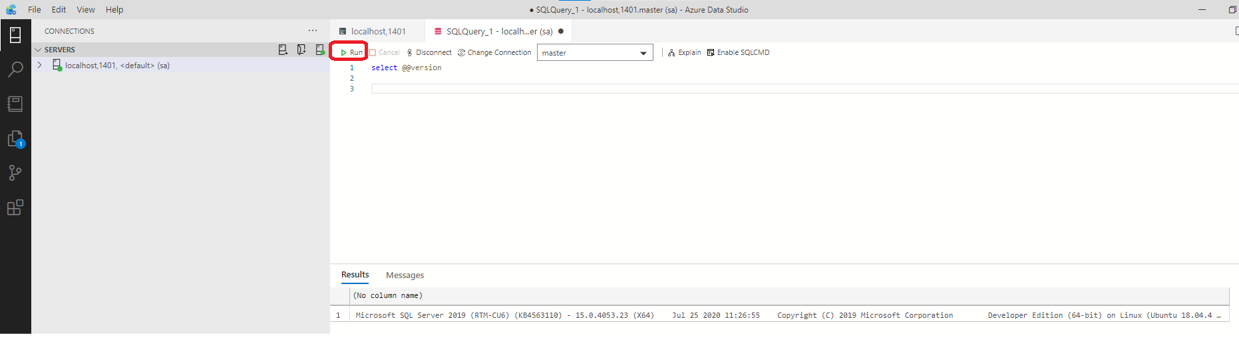
Azure Data Studio – my first query
Let’s run our first query on Azure Data Studio
Notes:
Why run on Docker container:
Speed and consistency

Slide 38
5. Creating new databases

Slide 39
Creating databases
Database server can contain one or more databases inside
On new server there are already created 4 system databases responsible for normal operation of the server
System databases
Master
Model
Msdb
Tempdb
Notes:
Master - Records all the system-level information for an instance of SQL Server
Model - Is used as the template for all databases created on the instance of SQL Server. Modifications made to the model database, such as database size, collation, recovery model, and other database options, are applied to any databases created afterward.
Msdb - Is used by SQL Server Agent for scheduling alerts and jobs.
Tempdb - Is a workspace for holding temporary objects or intermediate result sets.

Slide 40
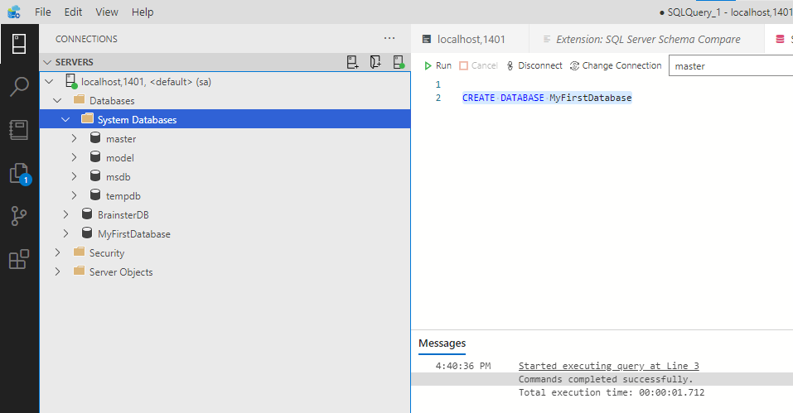
Create new database

Slide 41
Create new database – where it is stored
When new database is created two files are created to keep the data on the disk
When SQL is installed on Windows, the file path is directly on the windows file system
When SQL Server is installed on Docker, file is stored inside Docker container, and can be browsed by following command (PowerShell) row by row:
1. docker exec -it NameOfContainer bash
2. Cd var/opt/mssql/data
3. ls

Slide 42
6. Data types

Slide 43
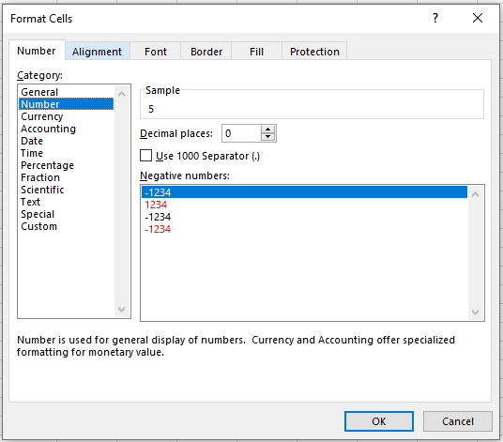
Data Types in SQL Server 1/3
How we define the data type in excel

Slide 44
Data Types in SQL Server 2/3
SQL Server uses strict data types when defining a table, variable or parameter.
Data types are separated into several groups:
Exact numeric ( int, smallint, bigint, decimal, bit, ... )
Approximate numeric (float, real)
Date and time (date, datetime, time, smalldatetime, datetimeoffset)
Character strings (char, varchar, text)
Unicode character strings (nchar, nvarchar, ntext)
Binary strings (binary, varbinary,image)
Other data types

Slide 45
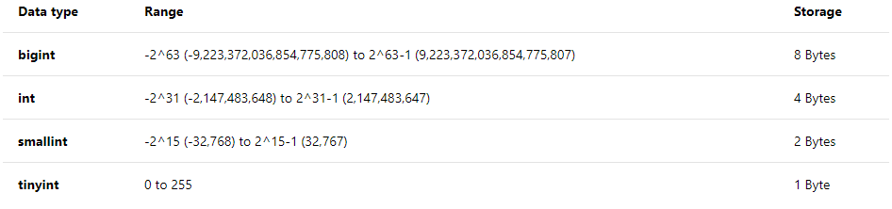
Data Types in SQL Server 3/3
Each data type is defined with range it covers and storage used
Example:
Full list of types explained: https://docs.microsoft.com/en-us/sql/t-sql/data-types/data-types-transact-sql?view=sql-server-2017

Slide 46
7. Creating tables

Slide 47
Creating tables - Basics
New table can be created with the following SQL Statement:
Schema concept – [SchemaName]
CREATE TABLE [SchemaName].[TableName] (
[Col1] [Data type 1],
[Col2] [Data type 2],
...
[ColN] [Data type N])

Slide 48
Creating tables – Keys and identities
Primary key uniquely identifies each row in the table
Primary key can be auto generated number, with pre-defined increments
NULL vs NOT NULL columns
IDENTITY (X,Y) meaning
Identity(1,1) – 1,2,3…
Identity(1,2) – 1,3,5…

Slide 49
Creating tables - Example
Create example table
CREATE TABLE [dbo].[Employee](
[ID] [int] IDENTITY(1,1) NOT NULL,
[FirstName] [nvarchar](100) NOT NULL,
[LastName] [nvarchar](100) NOT NULL,
[NationalIDNumber] [nvarchar](15) NULL,
[JobTitle] [nvarchar](50) NULL,
[DateOfBirth] [date] NULL,
[MaritalStatus] [nchar](1) NULL,
[Gender] [nchar](1) NULL,
[HireDate] [date] NULL,
CONSTRAINT [PK_Employee] PRIMARY KEY CLUSTERED
(
[ID] ASC
))

Slide 50
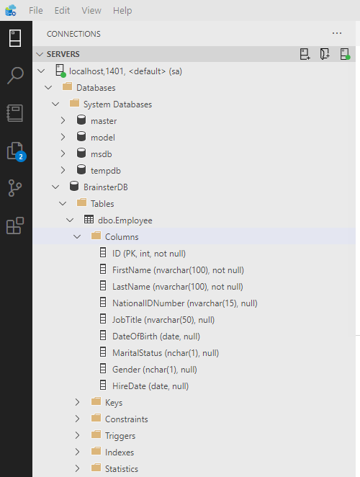
Example for created table

Slide 51
Creating tables – Deleting table
How to delete created table
DROP TABLE [dbo].[Employee]

Slide 52
8. Insert statement

Slide 53
Data manipulation - INSERT
Command basics:
Example:
Used when inserting atomic values
Used when we need to insert multiple records but this records already exists in another table
INSERT INTO [TableName] ([Column1],[Column2],...)
VALUES (Value1,Value2,...)
INSERT INTO dbo.Employee (FirstName,LastName, DateOfBirth)
VALUES (‘MyName’,’MySurname','1980.01.01')
INSERT INTO dbo.Employee (FirstName,LastName, DateOfBirth)
SELECT ' MyName2','MySurname2','1980.01.01'

Slide 54
9. Basic select statements

Slide 55
Data manipulation - SELECT
Command basics
Example:
SELECT *
FROM [TableName]
SELECT ColumnName1, ColumnName2 FROM [TableName]
SELECT ColumnName1, ColumnName2 FROM [TableName]
WHERE ColumnName1 = ‘XY’
SELECT *
FROM dbo.Employee
WHERE FirstName like ‘M%'

Slide 56
Basics of SQL Query statements
Components of select statement:
Execution order
FROM
WHERE
GROUP BY
HAVING
SELECT
ORDER BY
SELECT Columns - 5
FROM TABLES - 1
WHERE Conditions - 2
GROUP BY Columns - 3
HAVING Conditions - 4
ORDER BY Columns - 6

Slide 57
Basics of SQL Query statements 2/2
SELECT – can contain specific columns, all columns, combinations of columns
FROM – can contain one or more tables (combining tables will be next week topic)
WHERE – optional part. Can contain one or more conditions
GROUP BY – optional part. Can contain one or more columns (will be explained in details)
HAVING – optional part. Can contain one or more aggregate columns (will be explained in details)
ORDER BY - optional part. Can contain one or more basic or aggregate columns (will be explained in details)

Slide 58
10. Update statement

Slide 59
Data manipulation – UPDATE type 1
Command basics:
Example:
UPDATE [TableName]
SET Column1 = NewValue, Column2 = NewValue2
WHERE Column2 = SomeValue
UPDATE dbo.TestEmployee
SET FirstName = 'New name'
WHERE FirstName = 'MyName'

Slide 60
Data manipulation – UPDATE with Alias
Command basics:
-- update with Alias table
SELECT t.id, t.FirstName, t.LastName
FROM dbo.Employee t
WHERE FirstName = ‘MyName'
UPDATE t SET FirstName = My new name'
FROM dbo.Employee t
WHERE FirstName = 'MyName'

Slide 61
11. Delete statement

Slide 62
Data manipulation - DELETE
Command basics:
Example:
DELETE
FROM [TableName]
WHERE ColumnName = SpecificValue
DELETE
FROM dbo.Employee
WHERE FirstName = ‘MyName'

Slide 63
Table constraints

Slide 64
Table constraints
Types of Constraints
DEFAULT – insert default value if not specified in insert statement
CHECK – Additional checking of inserted data in column if specific condition is satisfied
UNIQUE – prevents duplicate values within a single column

Slide 65
Table constraints - Default
DEFAULT constraint supplies a default value during an INSERT if no other value is supplied
Can be defined during table creation, or afterwards
Example:
ALTER TABLE Employee
ADD CONSTRAINT DF_Employee_JobTitle
DEFAULT 'Officer' FOR JobTitle

Slide 66
Try at home
Extend the Employee table with 2 default constraints
1. If date of birth is not populated then insert 1980.01.01
2. If hire date is not populated then insert the current date as hire date
3. Bonus exam:
- Drop the constraint on date of birth
Add new constraint: If date of birth is not populated then insert the todays date but 30 years back (06.05.1990)

Slide 67
Table constraints - CHECK
CHECK constraint provides additional checking of inserted data in column if specific condition is satisfied
Can be defined during table creation, or afterwards
Example:
ALTER TABLE dbo.TestEmployee WITH CHECK
ADD CONSTRAINT CHK_TestEmployee_HireDate
CHECK (HireDate>='1980.01.01');

Slide 68
Table constraints - UNIQUE
UNIQUE constraint ensures uniqueness across data in a single column.
Guarantee that no more then one row can have the same value for specific column in the table
Can be defined during table creation, or afterwards
Example:
ALTER TABLE dbo.TestEmployee WITH CHECK
ADD CONSTRAINT UC_NationalIDNumber UNIQUE (NationalIDNumber)

Slide 69

Hands-on – DEFAULT, CHECK, UNIQUE
Notes:
Add additional constraints on the table

Slide 70
Hands – on –Try at home
Insert, update, delete
Insert your FirstName, LastName and Job title in the dbo.Employee table
Update the inserted data to fill the column Gender
Delete the inserted record
Constraints
Add default constraint to the table to have ‘M’ as gender if no data is populated

Slide 71
Client requirement
Work on specific client requirement

Slide 72
Design Bank personal accounts database 1/2
Bank has around 100 Employees
Bank has thousands of customers
Bank manages personal accounts for the customers
Each customer can have multiple accounts in different currencies
Changes in the account balance can be performed from different locations
regional and city branch offices
Web applications (internet bank, mobile banking,…)
ATM across the country
Clearing House

Slide 73
Design Bank personal accounts database 2/2
Personal accounts database should be able to store all account transactions
For each transaction database should keep information about the transaction details (date of transaction, amount, who performed the transaction, purpose of transaction, etc.)
Users should be able to generate different kind of reports based on this data (current balance, balance in specific moment in the past, total income, etc.)

Slide 74
Hands-on – Bank personal accounts database
Notes:
Show all possible select statements on TestEmployee table

Slide 75
Let’s create new database – name it BrainsterDB

Slide 76
Needed tables
Employee
Customer
Account (header, details)
Currency
Location (categorize locations in types)

Slide 77
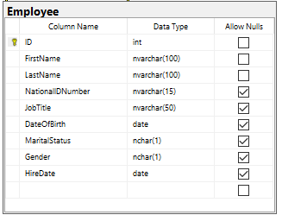
Employee table

Slide 78
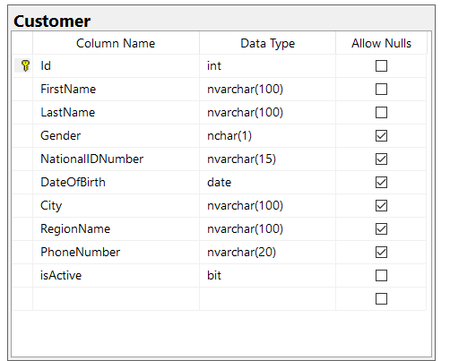
Customer table

Slide 79
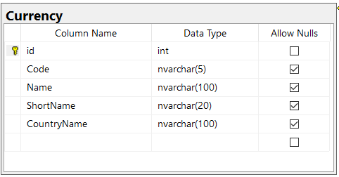
Currency table

Slide 80
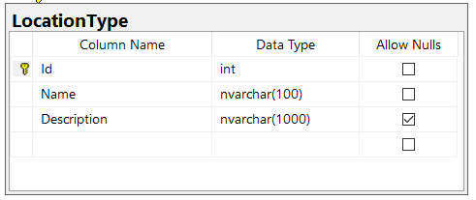
Location type table

Slide 81
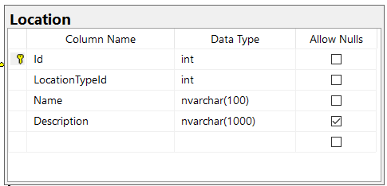
Location table

Slide 82
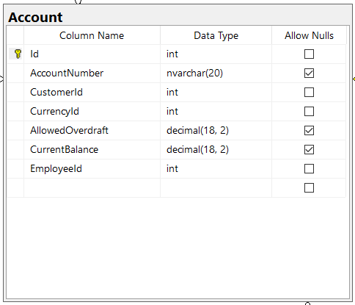
Account table

Slide 83
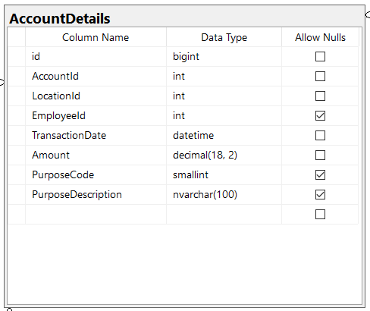
Account Details table

Slide 84
Azure data studio diagrams
https://github.com/R0tenur/visualization/releases/tag/v0.5.0

Slide 85
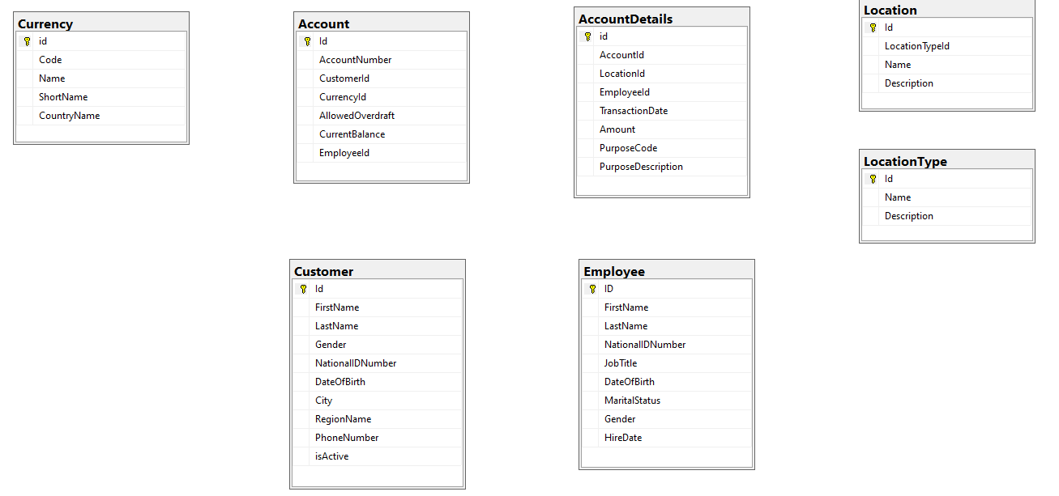
ER Diagram - Full database – no relations

Slide 86
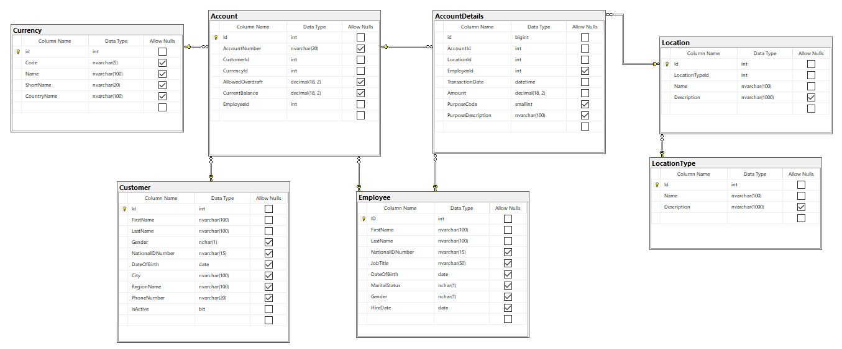
ER Diagram - Full database

Slide 87
Working with multiple tables

Slide 88
Working with multiple tables
Relational database engine means that data is structured to avoid storing duplicate data
Reduced disk capacity needed for storage
Reduced hardware resources needed for maintenance of the data
Single point of truth
Normalization forms used to describe the design concepts
Notes:
https://searchsqlserver.techtarget.com/definition/database-management-system

Slide 89
Data normalizations 1/3
First normal form
No repeating elements or groups of elements
Design:
New Design:
CustomerId | Account1 | Account2 | …
1 | 1 | 2
CustomerId | AccountId
1 | 1
1 | 2
Notes:
http://www.andrewrollins.com/2009/08/11/database-normalization-first-second-and-third-normal-forms/

Slide 90
Data normalizations 2/3
Second normal form
No partial dependencies on a concatenated key
If a column isn’t intrinsically related to the entire primary key, then you should break out the primary key into different tables
Example:
New design:
AccountId (PK) | CurrencyId | LocationId (PK) | TransactionDate(PK) | Amout
1 | 1 (MKD) | 1 | 2 | 100
AccountId (PK) | CurrencyId
1 | 1 (MKD)
Account Table
ID (PK) | AccountId | LocationId | TransactionDate | Amout
1 | 1 | 1 | 2 | 100
Account DetailsTable
Notes:
http://www.andrewrollins.com/2009/08/11/database-normalization-first-second-and-third-normal-forms/

Slide 91
Data normalizations 3/3
Third normal form
No dependencies on non-key attributes
Pull out columns that don’t directly relate to the subject of the row (the primary key), and put them in their own table
Example: Account details table (do not keep info for the Location name and type in all transactions)
Example:
ID (PK) | AccountId | LocationId | TransactionDate | Amout | LocationName | LocationType
1 | 1 | 1 | 2 | 100 | ATM Skopjanka | ATM’s
Notes:
http://www.andrewrollins.com/2009/08/11/database-normalization-first-second-and-third-normal-forms/

Slide 92
Foreign keys
Foreign keys and referential integrity

Slide 93
Foreign keys
Foreign keys are used to enforce foreign key relationships between tables, so that referenced data is always in existence for rows that reference it.
It is column or combination of columns in one table that serve as a link to look up data in another table
Value in the first table may be duplicated, but in the second table where you look up the corresponding value, it must be unique

Slide 94
Foreign keys - example
Syntax:
Example:
ALTER TABLE TableName WITH CHECK
ADD CONSTRAINT ConstraintName FOREIGN KEY(ColumnName)
REFERENCES AnotherTable (AnotherTableColumn)
ALTER TABLE [dbo].[Account] WITH CHECK
ADD CONSTRAINT [FK_Account_Employee] FOREIGN KEY([EmployeeId])
REFERENCES [dbo].[Employee] ([ID])
Notes:
ALTER TABLE [dbo].[Account] DROP CONSTRAINT [FK_Account_Employee]

Slide 95
Hands-on – Foreign keys
Notes:
Create foreign keys on all tables in the database
Test inserting invalid keys without foreign keys
With code
With ER diagram editor
Test inserting data in table with and without foreign keys

Slide 96

Notes:
2h workshop in total

Slide 97
Let’s first populate the database with test data
Notes:
Script for data generation will be provided

Slide 98
Workshop intro
Browse the tables
Make simple queries from each table to identify the data
Check how the tables are connected to each other – check the references
Investigate data with inline queries – will be learned in next period again

Slide 99
Workshop – 1
Data types and data manipulation – Account tables
Insert new Customer in the system
Insert new Employee in the system. Use your friend name
Insert 2 accounts for the new customer with the new Employee (EUR, USD)
Insert new location type in the database (Terminal)
Insert new location from type Terminal (e.g. Zara City mall post terminal)
Insert 1 transaction for each account we created in bullet 3 (income)
Insert 2 transactions for each account (outcome) as the transactions were performed from the Zara City Mall post terminal
Change the Allowed overdraft on EUR account to be 10.000

Slide 100
Homework 1
Constraints
Add default constraint with value = 930 on PurposeCode column in AccountDetails table
Add Unique constraint on Name column in Location table
Add Check constraint on Account table to prevent inserting negative values in AllowedOverdraft column

Slide 101
Workshop – 3
Basic querying
List all Customers with FirstName = ‘Mia’
List all Customers with FirstName = ‘Mia’ and LastName starting with letter G
Order the results by the LastName
Provide information about the total number of Customers with FirstName = ‘Mia’ OR LastName starting with G;
List all Customers that are born in February (any year)
List all Customers that are born in February (any year) or their last name starts with G
Provide total number of Female customers from Vienna
Provide total number of customers born in Odd months in any year

Slide 102
Workshop – 4 – try at home
Basic querying
Calculate how many customers from each city are in the system
Calculate how many male and female customers from each city are in the system
List only cities having more then 25 Female customers. Provide City name and total number of Female customers

Slide 103
Content 2
Week 2
Working with multiple tables
Foreign keys
Introducing table joins
Inner joins
Outer joins
Cartesian product using CROSS JOIN
Combining data sets
UNION and UNION ALL operator
INTERSECT operator
EXCEPT operator
Variables
Subqueries
Data Grouping
Workshop

Slide 104
Introducing table joins

Slide 105
Combining tables
T-SQL provides a number of different ways to combine data from multiple tables
Available options:
Joins
Subqueries
Table expressions
APPLY operator

Slide 106
Table joins
Data we usually query is spread across multiple tables. The more normalized the environment is, the more tables you usually have
The tables are usually related through keys, such as a foreign key in one side and a primary key in the other.
Joins can be used to query the data from the different tables and match the rows that need to be related.

Slide 107
Table join types
Joins can be categorized in following groups:
Inner Joins
Outer joins (Left, Right)
Cross joins

Slide 108
Inner joins

Slide 109
Inner joins
Inner join match rows from two tables based on a predicate—usually one that compares a primary key value in one side to a foreign key value in another side.
Inner join returns only matching rows - rows that exists in both tables
Table A
Table B
M rows
N rows

Slide 110
Inner joins - example
Table A
Table B
Joined tables
Column A
1
2
Column B
2
3
Column A | Column B
2 | 2
Table A
Table B
M rows
N rows

Slide 111
Hands-on – Inner join
Notes:
File: Week 2 - 01 Join example.sql
Create two tables with 1 column
Insert data in it
Try to make inner join (idA)
Try to join some of the Account tables

Slide 112
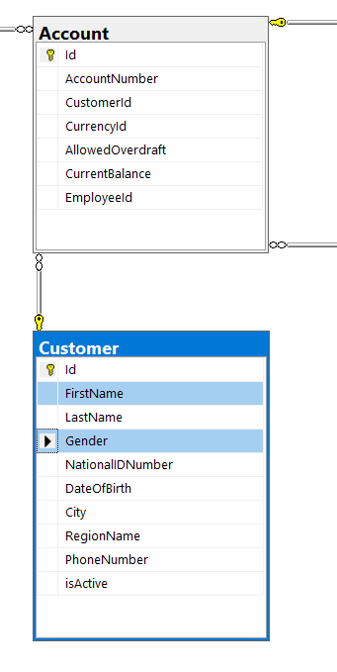
Hands on
List all informations for the account
+ First name an Gender of the customer
select a.* , e.id, e.FirstName, e.LastName, e.JobTitle
from dbo.Account as a
INNER JOIN DBO.Employee e ON a.EmployeeId = e.ID
ORDER BY a.id

Slide 113
Outer joins
Left join
Right Join
Full join

Slide 114
Outer joins
Outer join is used to preserve rows from one or both sides of the join, no mater if there is matching record on the other side
There are 3 types of outer joins:
LEFT (OUTER) JOIN
RIGHT (OUTER) JOIN
FULL (OUTER) JOIN

Slide 115
Inner joins - example
Table A
Table B
Joined tables
Column A
1
2
Column B
2
3
Column A | Column B
2 | 2
Table A
Table B
M rows
N rows

Slide 116
LEFT JOIN explained
Table A
Table B
Joined tables
Column A
1
2
Column B
2
3
Column A | Column B
1
2 | 2
Table A
Table B

Slide 117
RIGHT JOIN explained
Table A
Table B
Joined tables
Column A
1
2
Column B
2
3
Column A | Column B
2 | 2
 | 3
Table A
Table B

Slide 118
FULL JOIN explained
Table A
Table B
Joined tables
Column A
1
2
Column B
2
3
Column A | Column B
1
2 | 2
 | 3
Table A
Table B

Slide 119
Hands-on – Outer join
Notes:
File: Week 2 - 01 Join example.sql
Create two tables with 1 column
Insert data in it
Try to make left join (idA)
Try to join some of the Account tables
Try to make right and full joins
Practice the joins on Accounts database

Slide 120
Cross join
Cartesian product

Slide 121
Cross join
A cross join is used when you wish to create combination of every row from two tables. All row combinations are included in the result; this is commonly called cross product join. A common use for a cross join is to create obtain all combinations of items, such as colors and sizes.

Slide 122
Cross join - example
Joined tables
Table A
Table B
Column A | Column B
1 | 2
1 | 3
2 | 2
2 | 3
Column A
1
2
Column B
2
3
Table A
Table B
M x N rows
M rows
N rows

Slide 123
Hands-on – Cross join
Notes:
Test cross join on the test table with IDs
Do some tests with cross join from Accounts database

Slide 124
Hands-on
List all accounts in the system. Show the data for AccountNumber, CustomerName and CurrentBalance
Extend the previous query to show also CurrencyName
Extend the previous query to show First Name , Last name and Hire date of employee that opened the account
Design query that will list Customer First and Last Name, accountNumber, Current account balance and Currency

Slide 125
Customer and account with left and inner join
Insert 1 new customer
Don’t insert any accounts for it
Try inner and left join
First table to be account
First table to be customer
Where statement to filter just the new customer
Compare the differences

Slide 126
Combining data sets

Slide 127
Combining data sets
Set operators operate on two result sets of queries, comparing complete rows between the results. Depending on the result of the comparison and the set operator used, the operator determines whether to return the row or not.
T-SQL supports three set operators:
UNION (and UNION ALL)
INTERSECT
EXCEPT

Slide 128
UNION operator
UNION and UNION ALL

Slide 129
UNION and UNION ALL Operators
The UNION operator is used to combine the result sets of 2 or more SELECT statements.
Each SELECT statement within the UNION operator must have the same number of columns in the result sets with similar data types.
UNION
UNION ALL
Set1
Set2
Removed duplicates
Set1
Set2
Contains duplicates

Slide 130
Hands-on – Union and UNION all
Notes:
Week 2 - 02 Combining sets.sql

Slide 131
INTERSECT operator

Slide 132
INTERSECT Operators
INTERSECT operator returns only distinct rows that are common to both sets. If a row appears at least once in the first set and at least once in the second set, it will appear once in the result of the INTERSECT operator.
Set1
Set2

Slide 133
Hands-on – INTERSECT
Notes:
Week 2 - 02 Combining sets.sql

Slide 134
EXCEPT operator

Slide 135
EXCEPT Operator
EXCEPT operator returns only rows contained in the first table that doesn’t exists in the second table.
Second way to implement except is to use NOT IN operator and nested query
Set1
Set2

Slide 136
Hands-on – EXCEPT
Notes:
Week 2 - 02 Combining sets.sql

Slide 137
Hands-on Combining sets 1
List all Employee first names
Remove duplicate first names
List all Employee first names and Customer first names in single resultset
Remove duplicate first names on previous list

Slide 138
Hands-on 2
List all accounts in the system. Show the data for AccountNumber, CustomerName and CurrentBalance
Extend the previous query to show only data for accounts opened by employee with last name = ‘Eder’
Extend the previous query to show only accounts in USD currency
Find all Currencies for which there are open accounts in the system
Extend the previous query to show total number of Accounts per currency (challenge)

Slide 139
Variables

Slide 140
Variables - definition
Variables are declared in the body of a batch or procedure with the DECLARE statement and are assigned values by using either a SET or SELECT statement.
Types of variables
Scalar variables
Table variables
Temp tables

Slide 141
Variables - examples
Scalar variables
Table variables
Temporary tables
DECLARE @MyName NVARCHAR(10) = 'Blagoj'
DECLARE @CurrentYear int = 2019
DECLARE @MyCustomer TABLE (FirstName NVARCHAR(100), LastName NVARCHAR(100), City NVARCHAR(50))
INSERT INTO @MyCustomer values ('Aleksandar','Aleksovski','Skopje')
CREATE TABLE #MyCustomer (FirstName NVARCHAR(100), LastName NVARCHAR(100), City NVARCHAR(50))
INSERT INTO #MyCustomer values ('Aleksandar','Aleksovski','Skopje')

Slide 142
Try after each topic
Scalar variable:
Find all customers that has Mayer as last name and are born in February any year
Table variable
DECLARE table variable @MyEmployees ( NationalIdNumber)
declare @myGender scalar variable = 'M’/’F'
insert few NationalIdNumbers from the existing NationalIdNumbers
list all employees that has NationalIdNumber as @myEmployees table and has Gender as @MyGender scalar variable
Temp table
Same exercise but with temp table
Add additional parameter for day of birth and do testing with it

Slide 143
Hands-on – Variables
Notes:
Try to declare different variables and temp tables
Insert data

Slide 144
Hands-on Variables
Final goal:
Calculate the total Outflow amount for all ATM’s in Vienna and Graz performed by customers born after 1905.12.01
Steps:
Define scalar variable @DateOfBirth and assign a specific date – 1905.12.01
Find all Customers born after that date
Store the CustomerID data in temp table (#Customers (CustomerId int) )
Define Table variable @Locations (LocationId int)
Table variable should have only 1 column – LocationId
Table variable should contain ids for all ATM’s in Vienna and Graz
Calculate the total Outflow amount for all locations in @Locations variable and customers stored in #Customer table

Slide 145
Subqueries

Slide 146
Subqueries
A subquery is a query that is nested inside a SELECT, INSERT, UPDATE, or DELETE statement, or inside another subquery. A subquery can be used anywhere an expression is allowed.
Many Transact-SQL statements that include subqueries can be alternatively formulated as joins.
Main query and the subquery can be connected with different logical operators: =, IN, NOT IN, <> ,

Slide 147
Subqueries - example
Different currencies used for accounts:
Example with join :
Example with subquery:
SELECT DISTINCT c.Name, c.Code
FROM dbo.Currency c
INNER JOIN dbo.Account a on a.CurrencyId = c.id
SELECT DISTINCT c.Name, c.Code,
FROM dbo.Currency c
WHERE c.id in (SELECT a.CurrencyId FROM dbo.Account a )
Notes:
ALTER TABLE [dbo].[Account] DROP CONSTRAINT [FK_Account_Employee]

Slide 148
Hands-on – Subqueries
Notes:
Izrabotete lista na ATM na koja ke gi prikazete ATM uredite na koi imalo isplati pogolemi od 1500 den vo mesec 03.2019

Slide 149
Try at home
Get all locations that are from type ATM (join location type)
Do the same with subqueries

Slide 150
Try at home - Subqueries - challenge
Prepare list of ATM locations where you will list all ATM ‘s where there was at least 1 outflow transaction greater than 150 EUR in month 03.2019
Notes:
Steps:
List all transactions in 03.2019 for outflow amounts greater than 1500
List the Location names for the transactions from the previous query

Slide 151
Data grouping and computing aggregates

Slide 152
Data grouping and computing aggregates
Grouping the data in sets is achieved by using GROUP BY function
The groups are determined by the columns that you specify in the GROUP BY clause
Format:
Example:
SELECT Column1, Aggregate(column2)
FROM Table1
GROUP BY Column1
SELECT a.AccountId, COUNT(*) as CurrentBalance
FROM dbo.AccountDetails a
GROUP BY a.AccountId

Slide 153
Most common aggregation functions
MIN – minimum
MAX – maximum
AVG – average
COUNT – total number
SUM – summarized amount
SELECT a.AccountId, SUM(Amount) as CurrentBalance, MIN(Amount), MAX(Amount), AVG(Amount), COUNT(Amount)
FROM dbo.AccountDetails a
GROUP BY a.AccountId

Slide 154
Filtering by aggregates
When aggregated data should be additionally filtered by the value of aggregate we use HAVING function
Example:
SELECT a.AccountId, SUM(Amount) as CurrentBalance
FROM dbo.AccountDetails a
GROUP BY a.AccountId
HAVING COUNT(*) = 7

Slide 155
Hands-on – Data grouping
Notes:
Find the biggest outflow per ATM machine, for the first 3 months of 2019

Slide 156
HANDS-on Data grouping
Find the smallest transaction in each Location
Output should contain LocationId and Amount
Extend the Output to contain LocationId, Location Name and Amount
Find the smallest transaction in each Month and Year
Output should contain Month name, Year and Amount
Find the biggest outflow per ATM machine, for the first 3 months of 2019

Slide 157
Window functions

Slide 158
Window functions
Window aggregate functions are the same as the group aggregate functions (for example SUM, COUNT, AVG, MIN, and MAX), except window aggregate functions are applied to a window of rows defined by the OVER clause
Window functions do not hide the details – every row returned
Mixing between details and aggregated elements
Example:
AccountId | Transaction date | Amount | Count of transactions current Month
1 | 2019.01.03 | - 500 | 12
1 | 2019.01.04 | - 1500 | 12

Slide 159
Window functions
Syntax:
Example (total amount of outflow and total outflows per account):
SELECT column1, column2,...columnN,
AGGREGATE_Function OVER( PARTITION BY Column, ORDER BY Column)
FROM Table
WHERE condition
SELECT AccountId,
LocationId,
TransactionDate,
Amount,
SUM(Amount) OVER(PARTITION BY AccountId) as TotalPerAccount,
SUM(Amount) OVER() as GrandTotal
FROM dbo.AccountDetails a
ORDER BY AccountId,TransactionDate

Slide 160
Hands-on – Window functions
Notes:
Find total amount of outflow per location in the month 03.2019
List Location name next to each location Id

Slide 161
Hands on – windowing functions
Find total amount of outflow per location in the month 03.2019
List Location name next to each location Id
Implement this with Windowing
Try at home
Do the same exercise with Subqueries and Group By
Do the same exercise with Inner join and Group by

Slide 162
Window Ranking functions

Slide 163
Window Ranking functions
With window ranking functions you can rank rows within a partition based on specified ordering.
As with the other window functions, if you don’t indicate a window partition clause, the entire underlying query result is considered one partition.
The window order clause is mandatory
Functions:
ROW_NUMBER
RANK
DENSE_RANK
NTILE

Slide 164
Window ranking functions
Example (All ranking functions applied on AccountDetails amounts):
SELECT AccountId, TransactionDate, Amount,
ROW_NUMBER() OVER(ORDER BY Amount) AS rownum,
RANK() OVER(ORDER BY Amount) AS rnk,
DENSE_RANK() OVER(ORDER BY Amount) AS densernk,
NTILE(100) OVER(ORDER BY Amount) AS ntile100
FROM dbo.AccountDetails;

Slide 165
Hands-on – Window ranking functions
Notes:
Week 3 - 01 Windows ranking functions hands on.sql
Order all transactions from Clearing houses from highest to lowest transaction by using RowNumber function

Slide 166
Hands - on
Order all transactions from Clearing houses from highest to lowest transaction by using RowNumber function
Show the following data on output:
LocationName
AccountId
Amount
Rn (the ordering column)

Slide 167
Challenge – try within your group
AccountId | TransacactionDate | Amount | BalanceAfterTransaction
1 | 01.01.2021 | 4000 | 4000
1 | 02.01.2021 | -100 | 3900
1 | 05.01.2021 | -500 | 3400
2 | 01.01.2021 | 5000 | 5000
2 | 02.01.2021 | -1000 | 4000
2 | 05.01.2021 | -3000 | 1000

Slide 168
Common table expressions

Slide 169
Common table expressions
CTE specifies a temporary named result derived from a simple query and defined within the execution scope of a single SELECT statement
Used to better organize the code apply further restrictions to the resultset
Syntax:
WITH <CTE_name>
AS
(
<inner_query>
)
<outer_query>;

Slide 170
Common table expressions - example
If we want to apply further restrictions to the ranking function from hands-on, to filter only 5 highest transactions from all Clearing houses, we can use CTE
;WITH myCTE as
(
SELECT AccountId, amount, row_number() OVER (Order by Amount desc) as rn
FROM dbo.AccountDetails d
INNER JOIN dbo.Location l on l.Id = d.LocationId
INNER JOIN dbo.LocationType lt on lt.id = l.LocationTypeId
WHERE lt.Name = 'Clearing House'
)
SELECT *
FROM myCTE
WHERE rn <= 5

Slide 171
Hands-on – Common table expressions
Notes:
Extend the query for top 5 transactions to show top 5 transactions for different clearing house (KIBS, MIPS)

Slide 172
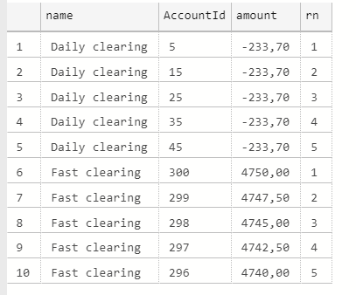
Hands on
Extend the query for top 5 transactions to show top 5 transactions for different clearing house

Slide 173
Hands on
Prepare query that will show smallest 2 transactions from each location in February, 2019. Query should include the owner or the account as well.
Columns on output:
LocationName
Amount
Customer name (First Name and Last name in same column)

Slide 174
Challenge 4 - Friday
Prepare query with 2 most often used locations for transactions for the male customers and for the female customers.
This are the columns expected on output (note: data shown here is just an example and it is not showing the final expected result)
Gender | Location | Total transactions in this year
Male | ATM Vienna 1 | 100
Male | Salzburg branch office | 95
Female | Daily clearing | 55
Female | Graz branch office | 45

Slide 175
Functions
Built-in functions
Scalar-valued functions
Table-valued functions

Slide 176
Built-in functions
Built-In functions are used in SQL SELECT expressions to calculate values and manipulate data. These functions can be used anywhere expressions are allowed.
Numeric functions
ABS(), ROUND(), SQRT(), CEIL() ,…
String functions
UPPER(), LTRIM(), LENGTH(),…
Link with built-in functions listed
https://www.cs.utexas.edu/~mitra/csFall2009/cs329/lectures/sqlFunc.html

Slide 177
Hands-on – Build-in functions
Notes:
Try something with replace function – for example: Replace Partizanska Skopje string with Ilindenska Skopje

Slide 178
Hands-on
Update Location data to change ATM name with Cash machine.
For example:
old name: ATM Graz 1
New name: Cash machine Graz 1

Slide 179
Try at home
Pick one location from locationtypeid = 4
Update the name of the location to contain ATM in the middle:
Example: ‘Vienna ATM device’
Prepare an update that will change this record into “Vienna Cash machine device”
When you are finished:
In order to get the data in the initial state – update Cach machine back to ATM ☺

Slide 180
Scalar-valued functions
Scalar functions are used in order to encapsulate some more complex logic which can be reused in any T-SQL Statement
Basic characteristics of scalar function are:
It returns only a single specific value.
It can accept multiple parameters, perform calculation, and then return a single value.
The value is passed back through the function by means of RETURN command, and every possible code path within the UDF should conclude with the RETURN command.
It can used inside any expressions in SQL Server, in fact inside the check constraint, but are not advisable to use their cause of performance matrix

Slide 181
Scalar –valued functions - example
CREATE FUNCTION dbo.FunctionName (@ParametarList int)
RETURNS INT
AS
BEGIN
DECLARE @Result INT
-- Your code comes here
RETURN @Result
END
How to call:
select dbo.FunctionName (2)

Slide 182
Scalar –valued functions - example
CREATE OR ALTER FUNCTION dbo.fn_TotalTransactionsForCustomer (@CustomerId int)
RETURNS INT
AS
BEGIN
DECLARE @Result INT
SELECT @Result = COUNT(*)
FROM dbo.Account a
INNER JOIN dbo.AccountDetails d on a.id = d.AccountId
WHERE a.CustomerId = @CustomerId
RETURN @Result
END
How to call:
select dbo.fn_TotalTransactionsForCustomer (2)

Slide 183
Hands-on – Scalar valued functions

Slide 184
Hands-on
Prepare function that for CustomerId on input will return the current balance of his EUR account
Dbo.MyEURAccountBalance(@CustomerId)
Output: decimal(18,2)
Step 2:
Expose the currency to be on input
Dbo.MyAccountBalanceV2(@CustomerId, @CurrencyId)
Output: decimal(18,2)

Slide 185
Try at home
Create a scalar function that for input:
CustomerId
CurrencyId
Date
Function will return the current balance for that customer and Currency on specific Date

Slide 186
Table-valued functions
A table-valued function is a user-defined function that returns data of a table type. The return type of a table-valued function is a table, therefore, you can use the table-valued function just like you would use a table.
Basic characteristics of table valued function are:
It can accept multiple parameters, perform calculation, and then return a full resultset
It returns resultset with one or multiple rows

Slide 187
Table –valued functions - example
CREATE FUNCTION dbo.fn_TotalTransactionsForCustomerAndCurrency (@CustomerId int)
RETURNS @ResultSet table (CurrencyCode NVARCHAR(10), NumOfTransacions int)
AS
BEGIN
INSERT INTO @ResultSet (CurrencyCode,NumOfTransacions)
SELECT c.ShortName, count(*)
FROM dbo.Account a
INNER JOIN dbo.AccountDetails d on a.id = d.AccountId
INNER JOIN dbo.Currency c on c.id = a.CurrencyId
WHERE a.CustomerId = @CustomerId
GROUP BY ShortName
RETURN
END
How to call:
select * from dbo.fn_TotalTransactionsForCustomerAndCurrency(2)

Slide 188
Hands-on – Table valued functions

Slide 189
Hands on
Create function that will return the total number of transactions per location type ( total ATM transactions, total Clearing house transactions, etc…) for validity period defined on input of function
Help:
-- input: (@CustomerId, @validFrom date, @ValidTo date)
Example output:
ATM - 5
Clearing house - 1
Branch office - 2

Slide 190
Stored Procedures

Slide 191
Stored procedures
A stored procedure in SQL Server is a group of one or more Transact-SQL statements used to Read, Transform and Modify data
Main characteristics are:
Accept input parameters and return multiple values in the form of output parameters to the calling program.
Return zero, one or more result sets when executed
Contain programming statements that perform operations in the database. These include calling other procedures
Return a status value to a calling program to indicate success or failure (and the reason for failure).

Slide 192
Stored procedures
Key benefits of using stored procedure in the database are:
Reduced server/client network traffic – single batch execution and no need for back and forth of data to client side
Stronger security – RDBMS can fully manage the permissions for the procedure
Code reusability – no need for re-typing the same code on multiple places
Improved performance – generated execution plan that will be reusable for next executions
Easier maintenance – having unique logic stored in a single place reduces the time needed for changes to existing code

Slide 193
Stored procedures – how to create
CREATE PROCEDURE schemaName.ProcedureName (@Paraleter1 datatype, @Parameter2 datatype,...)
AS
BEGIN
Variable declaration
T-SQL statements ...
Output (select statements)
END

Slide 194
Stored procedures – example
Create procedure for adding new Employee
As output the procedure should return single resultset with 3 columns
Total Number of existing employees born in the same month as the new employee
Total Number of existing employees having same first letter in the last Name as the new employee
Total number of employees hired in the same year as the new employee
Create the procedure step by step from scratch to show how this should be done

Slide 195
Hands-on – Stored Procedures

Slide 196
Hands-on – Day 1
Create procedure that will add new transactions in the system. Procedure should be used by M-bank application
Procedure name: NewMbankTransaction
Input parameters: CustomerId , Currency code, TransactionDate, Amount, PurposeCode
Output: New balance on the customer account
Note: insert data only in AccountDetails table (do not correct the CurrentBalance)
Improve the procedure to update the CurrentBalance column on Account level (dbo.Account table) after each transaction

Slide 197
Hands – on – Day 2
Prepare procedure that will be used to generate report for customer balance at specific date
Input: CustomerId, Date
Output: CustomerName, Balance on date , Currency Short Name
Extend the procedure to log all calls for the report in new table
Log should contain info about the employee (employeeId) requested the report, customerId and date.
Logs should be written in new table - CustomerReportLogs
Challenge 5

Slide 198
Conditions

Slide 199
Conditions
Conditions provides the ability to execute some code if specific conditions are meet
Ways to set conditional logic:
IF – THEN – ELSE statement
CASE statement

Slide 200
Conditions – IF – THEN – ELSE statement
The IF/ELSE construct gives the ability to conditionally execute code. You enter an expression after the IF keyword, and if the expression evaluates as true, the statement or block of statements after the IF statement will be executed.
You can use the optional ELSE to add a different statement or block of statements that will be executed if the expression in the IF statement evaluates to false.
DECLARE @var1 AS INT = 1
DECLARE @var2 AS INT = 2
IF @var1 = @var2
PRINT 'The variables are equal';
ELSE
PRINT 'The variables are not equal';
GO

Slide 201
Conditions – IF – THEN – ELSE statement
In case when there is more than 1 expression in the block – BEGIN – END must be used:
DECLARE @var1 AS INT = 1
DECLARE @var2 AS INT = 2
IF @var1 = @var2
BEGIN
PRINT 'The variables are equal'
END
ELSE
BEGIN
PRINT 'The variables are not equal';
END

Slide 202
Hands-on - 1
Create procedure that will be used for inserting new employee (all columns in Employee tables should be inserted)
Add control check if the new employee is older then 18 years in the moment of employment
If the employee has 18 years then insert the record
If the employee is under 18 years print informational message (“Too young to be employed”)

Slide 203
Hands-on – 2 – try at home (share with everyone)
Create procedure that will add new transactions in the system. Procedure should be used by M-bank application
Procedure name: NewMbankTransaction
Input parameters: CustomerId , Currency code, TransactionDate, Amount, PurposeCode
Output: New balance on the customer account
Change the existing procedure (NewMbankTransaction) to check if the new transaction will satisfy the allowed overdraft for that account (outcome transaction)
Example: current balance 1000 , allowed overdraft 10.000
Ok test: -5.000 , +5000
Not ok: -15.000

Slide 204
Conditions – CASE statement
The CASE construct gives the ability to conditionally execute code, but within a single select statement. Expression can contain one or multiple case statements:
DECLARE @var1 AS INT = 1
DECLARE @var2 AS INT = 2
SELECT CASE WHEN @var1 = @var2 THEN 'The variables are equal'
ELSE 'The variables are not equal'
END
SELECT CASE WHEN @var1 = @var2 THEN 'The variables are equal'
WHEN @var1 > @var2 THEN 'Var1 is greather then Var2'
ELSE 'Var1 is smaller then Var2'
END

Slide 205
Hands-on – try at home
List all employee First and Last names and add 1 more column to the output which will contain information about the duration of employment:
“Less then 20 Years in the company” – if employed after ‘2000-01-01’
“More then 20 years in the company” – if employed before ‘2000-01-01’
Create new procedure – Check total Employees on date:
Procedure name: dbo.TotalEmployeesOnDate
Input: @HireDate
Output: 1 result set with 3 columns:
Total employees on @Hiredate
Total employed after the @Hiredate
isMature - If the “Total employees on date” is bigger then “Total employed after the date” then set to 1, otherwise set to 0

Slide 206
Iterations

Slide 207
Iterations – While loop
Iterations main purpose is to execute multiple times the same T-SQL code
The simplest way to implement iterations is WHILE statement
We need to provide mechanism to stop the execution at some point of time in order to avoid infinite loop
DECLARE @count AS INT = 1;
WHILE @count <= 10
BEGIN
SELECT CAST(@count AS NVARCHAR);
SET @count = @count + 1;
END;

Slide 208
Hands-on - 1
Extend the previous query to print the following numbers using iterations: 1,2,3,4,5,7,9
Hint: use WHILE loop and IF statements

Slide 209
Hands-on - 2
Task 1:
Execute the procedure NewMbankTransaction in a loop, to add new outflow transactions for the customers with ID: 1,2,4,8,16,32,64,…
Task 2:
Create new procedure for fixing the current balance - FixCurrentBalance
Procedure need to go trough all accounts (with while loop) and if there is inconsistency between balance in transactions and the summarized balance to fix it
Procedure input: @AccountId
Output: N/A
Measure the execution time on the procedure

Slide 210
Contact
Contact mail:
blagojk@gmail.com
LinkedIn profile:
https://www.linkedin.com/in/blagojkostovski/

Slide 211
Thank you

